Slide 1
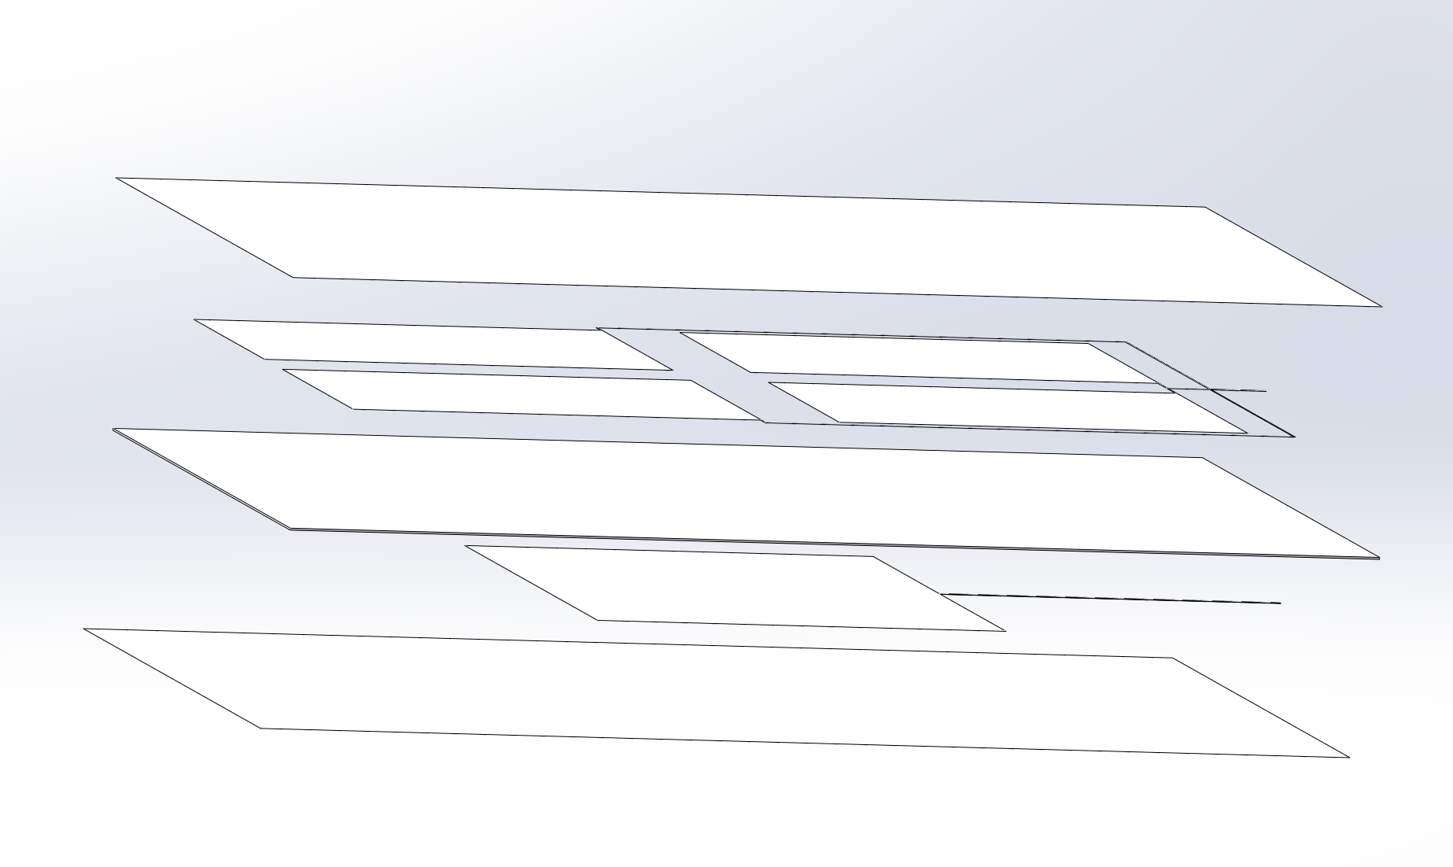

Slide 2
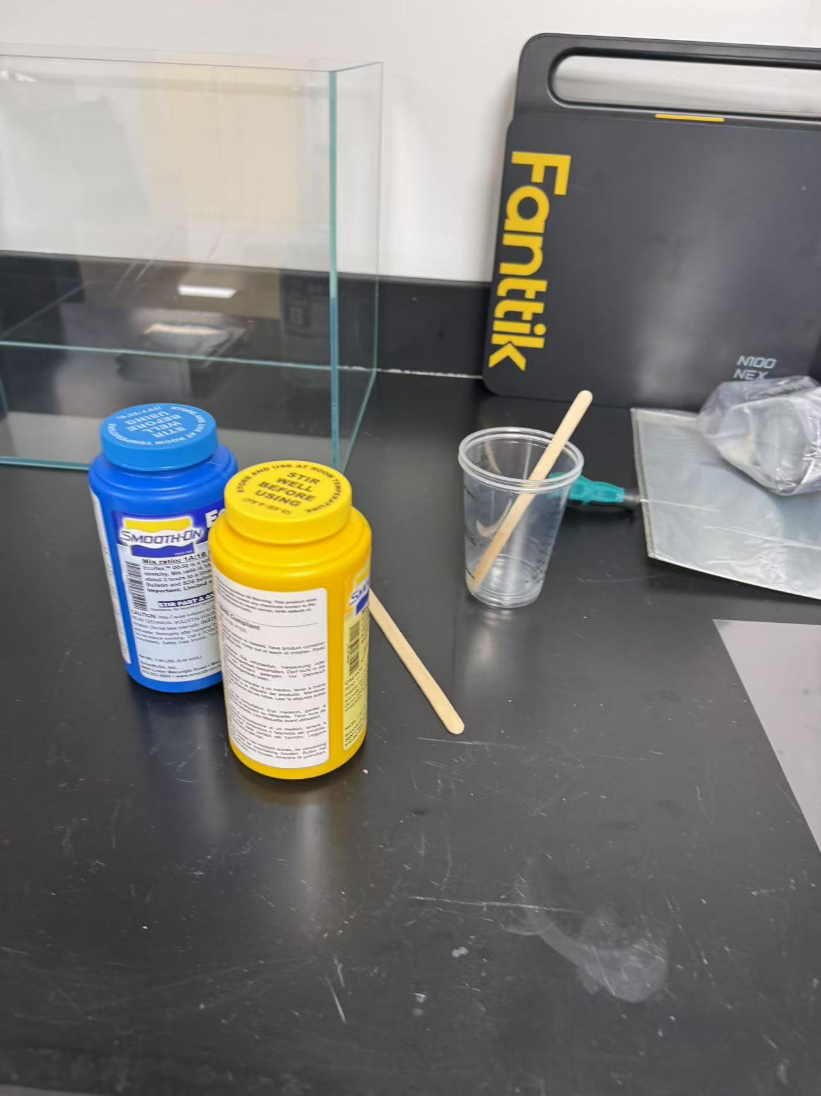
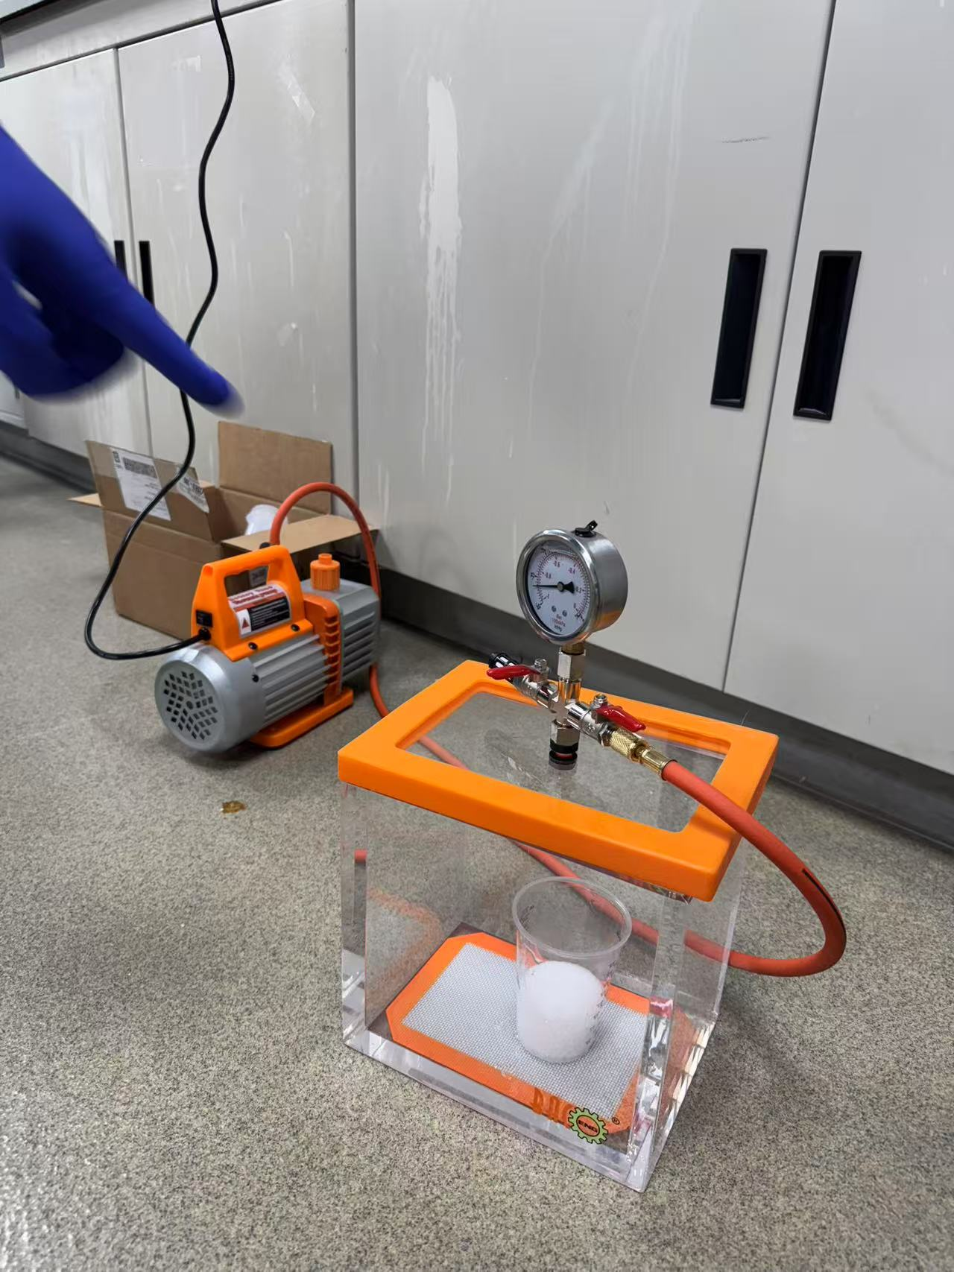
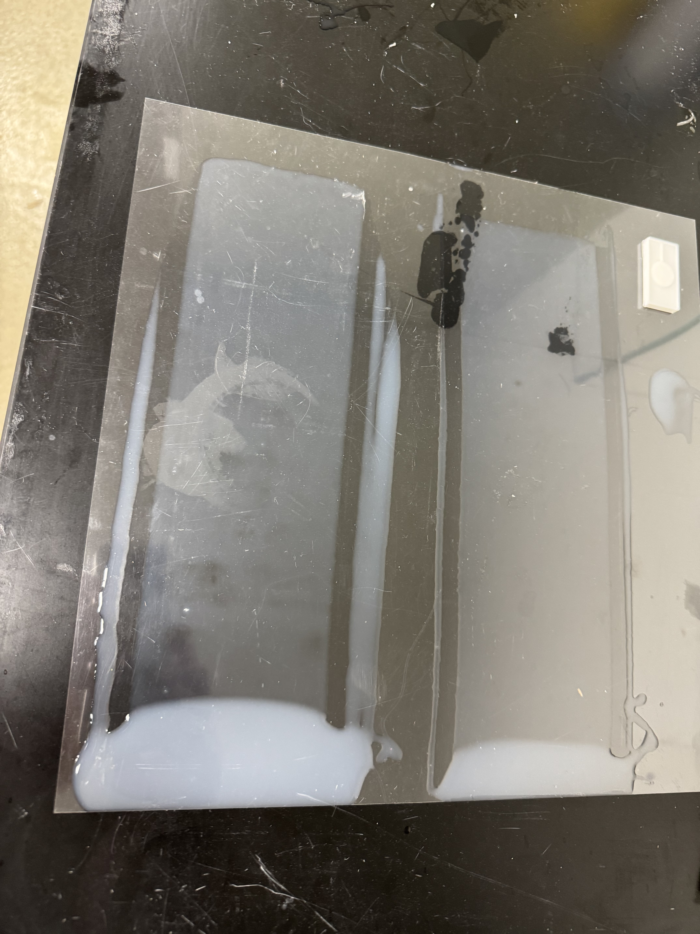
Insulation Films

Slide 3
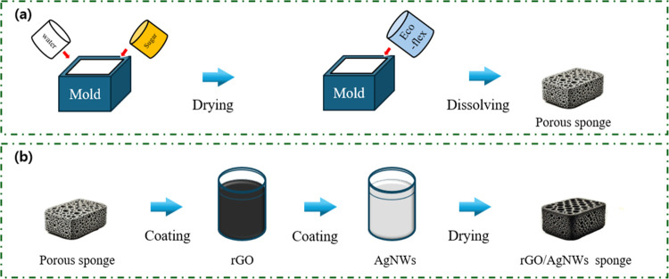
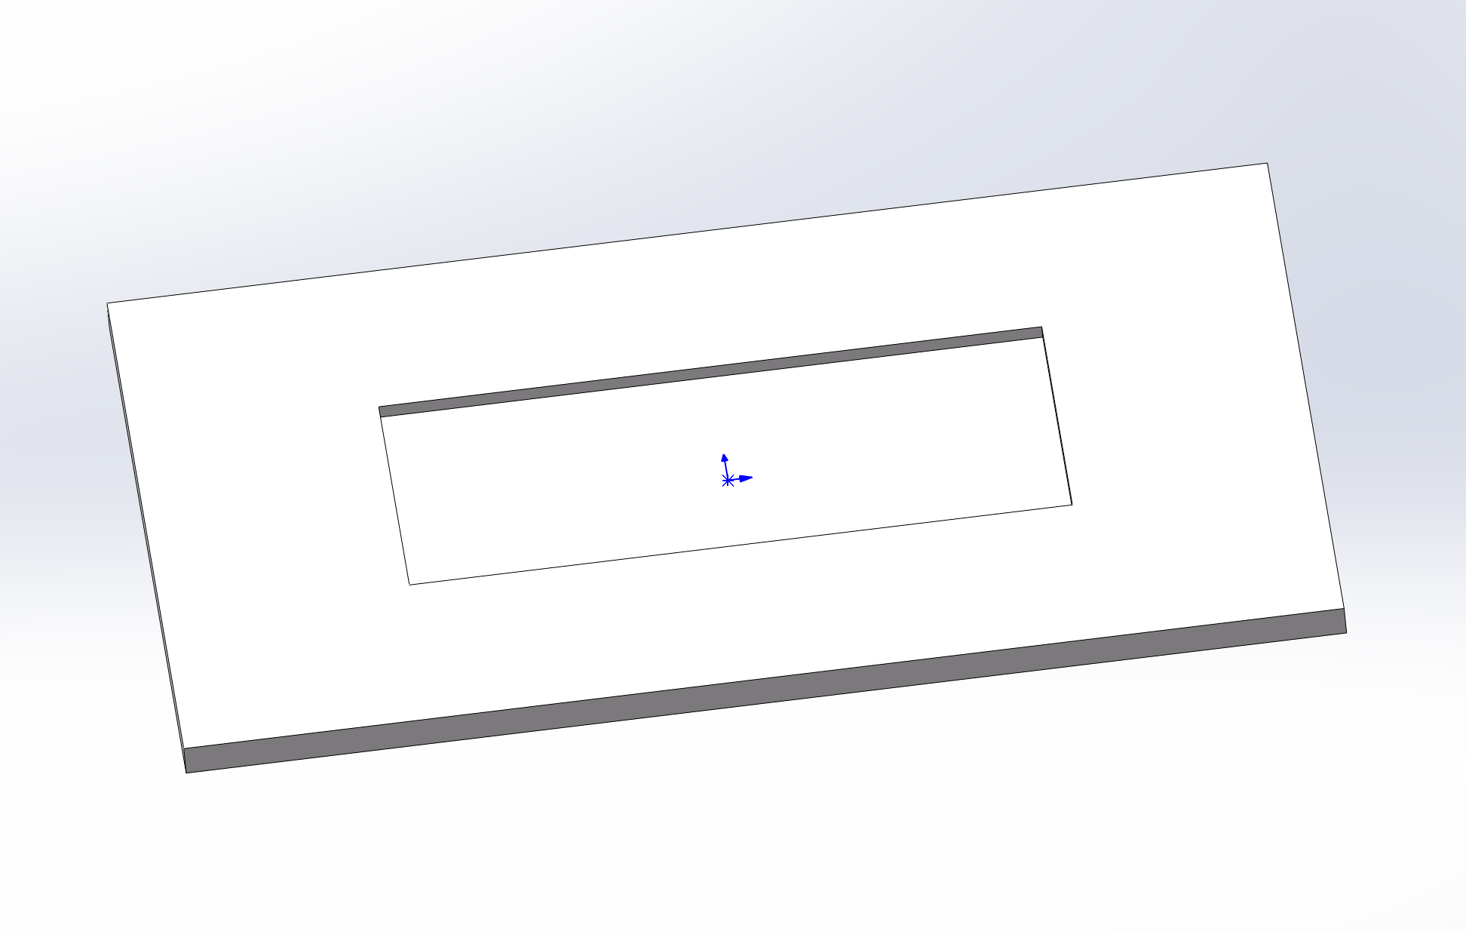
Porous Ecoflex Dielectric
https://pmc.ncbi.nlm.nih.gov/articles/PMC11603251/
Sugar was placed in a mold and sprayed with water to fabricate the 3D sugar template. Subsequently, the moistened sugar was dried in an oven at 80 °C for 30 min.
Subsequently, we mixed a precursor (referred to as Part A) and a curing agent (Part B) in a 1:1 ratio for an Ecoflex 00–30(Smooth-on), the renowned product name for poly(butylene adipate-co-terephthalate) (PBAT) copolymer.
Subsequently, the mold containing the ecoflex mixture and sugar template was placed in a vacuum chamber for 30 min to remove the air bubbles. After the air bubbles were completely removed, the ecoflex mixture in the mold with the sugar template was cured in an oven at 60 °C for 1 h.
Finally, the sugar was dissolved in deionized water at 90 °C, yielding a porous sponge structure.

Slide 4
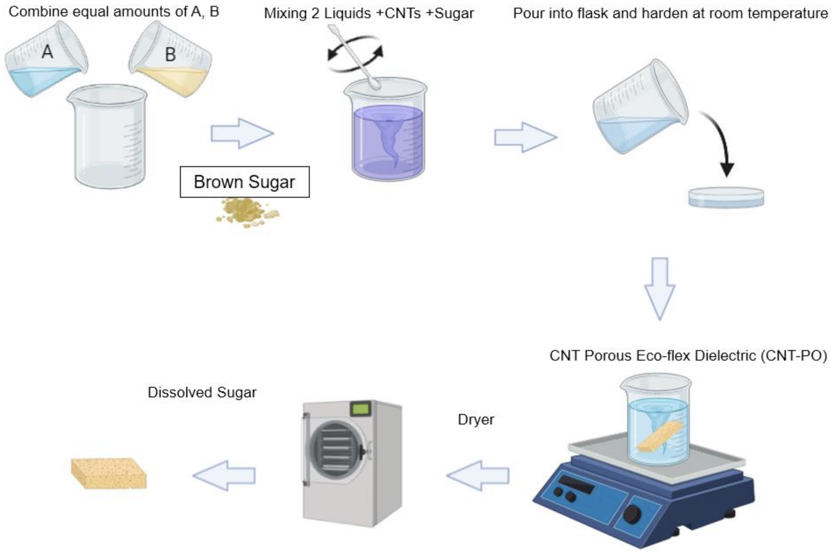
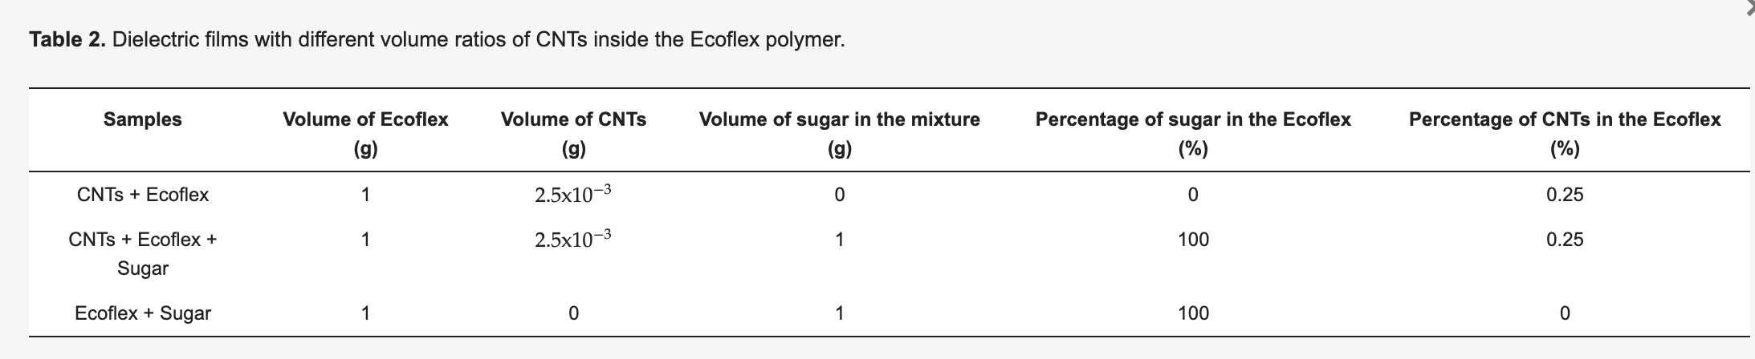
Porous Ecoflex Dielectric Method2
https://www.mdpi.com/2073-4360/14/17/3446
The CNTs microporous dielectric layer or pressure-sensing layer was fabricated using the process shown in Figure 5. The eco-flex solution was obtained by mixing a base (Part A) and a cured agent (Part B) with a volume weight ratio of 1:1. Following this process, granulated brown sugar and CNTs were dispersed in the Ecoflex solution. The different dielectric films were obtained by changing the volume weight ratio of CNTs and Sugar distributed in the Ecoflex, as shown in Table 2. The solution was stirred at 120 rpm for 15 min to help segregate granulated brown sugar and evenly distribute it in the composite. The mixture was cured at room temperature (30 °C) for 3 h. To form the shape of the dielectric films, we used a 3D mold with the length, width, and height of electrodes of the same size (20 mm × 20 mm × 7 mm). Following the curing time, the mixer was removed from the 3D mold, and the sugar was dissolved in boiler water under magnetic stirring at 200 rpm for at least 24 h. Porous Ecoflex Dielectric (ECO-PO) is the sample with air due to the formation of pores. In contrast, non-porous Eco-flex Dielectric (ECO-NPO) was the sample in which no pores were formed because sugar was absent. Similarly, CNT-NPO and CNT-PO are non-porous and porous samples with CNTs.

Slide 5
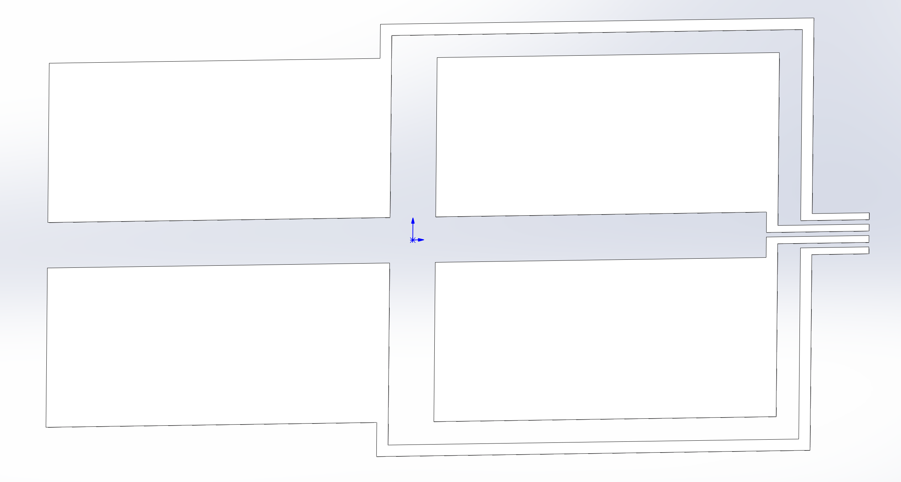
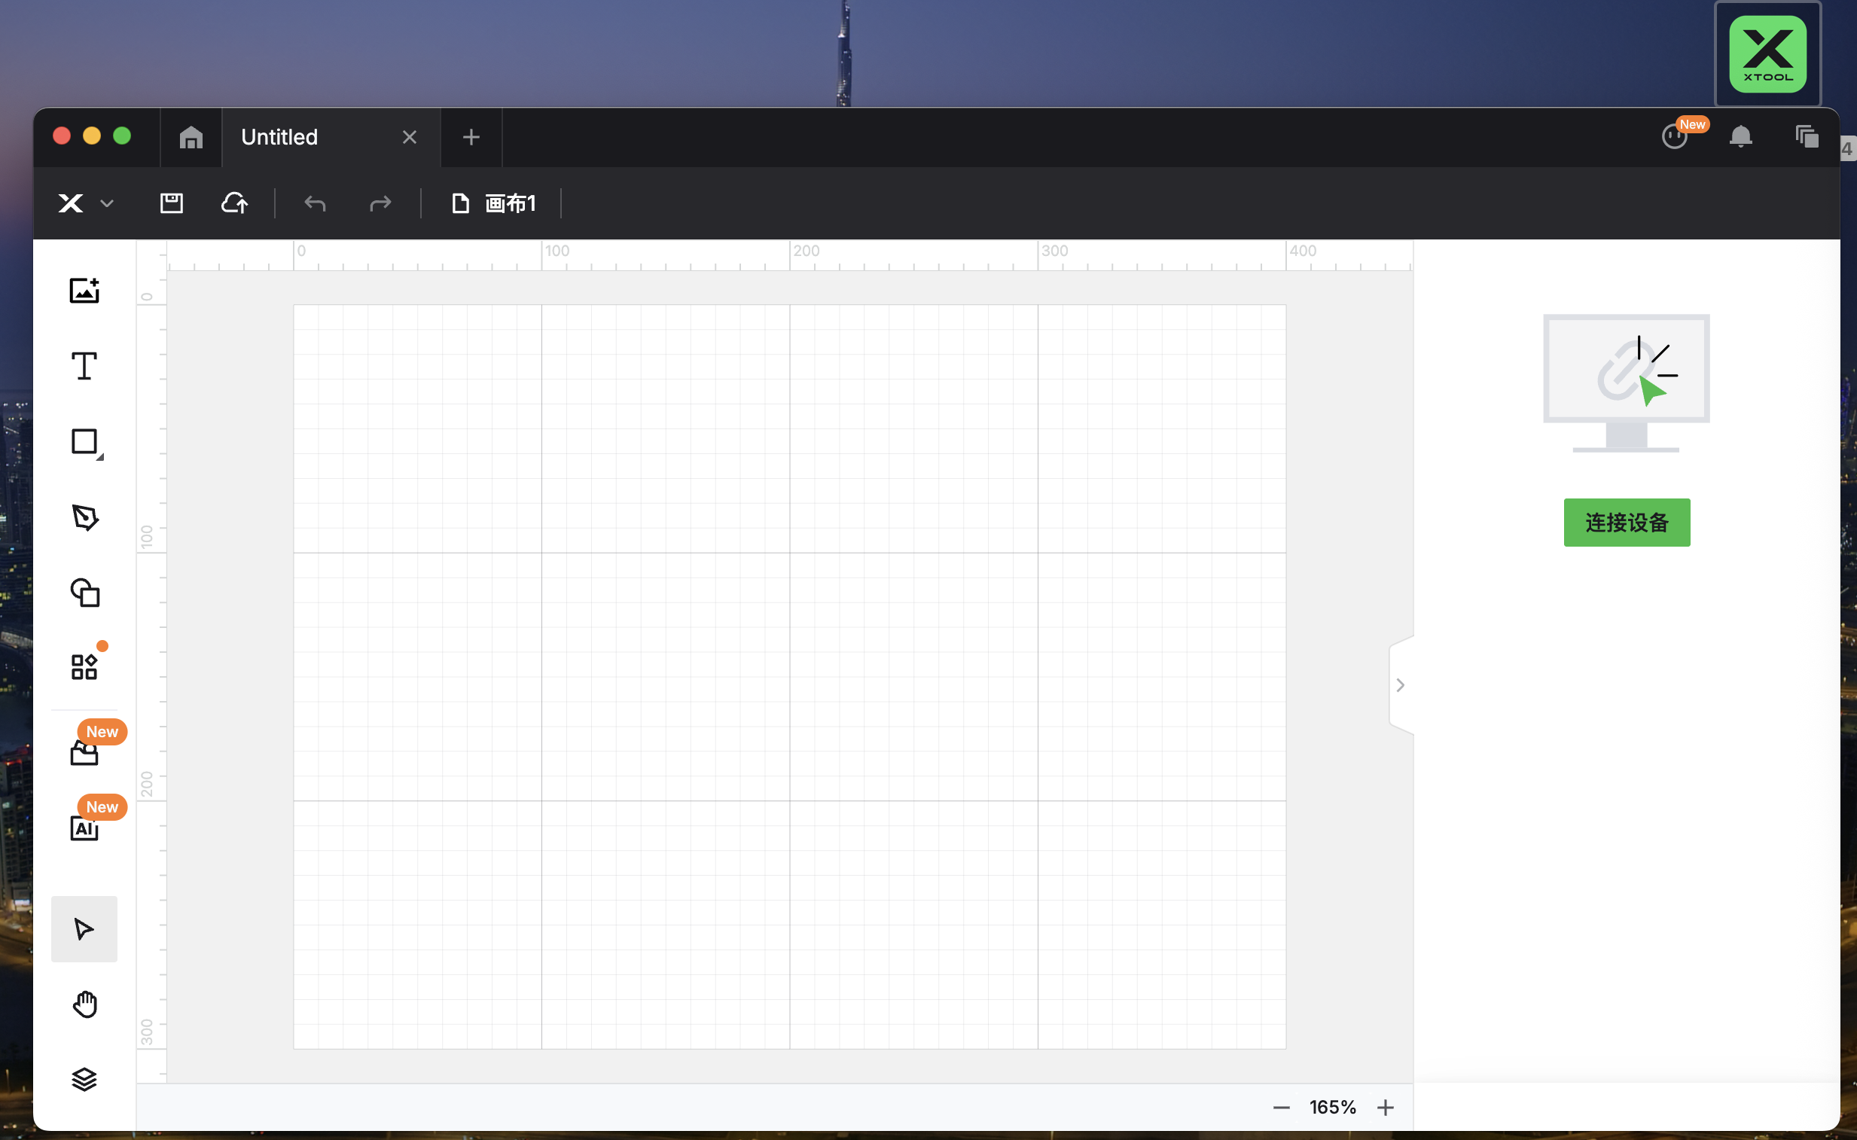
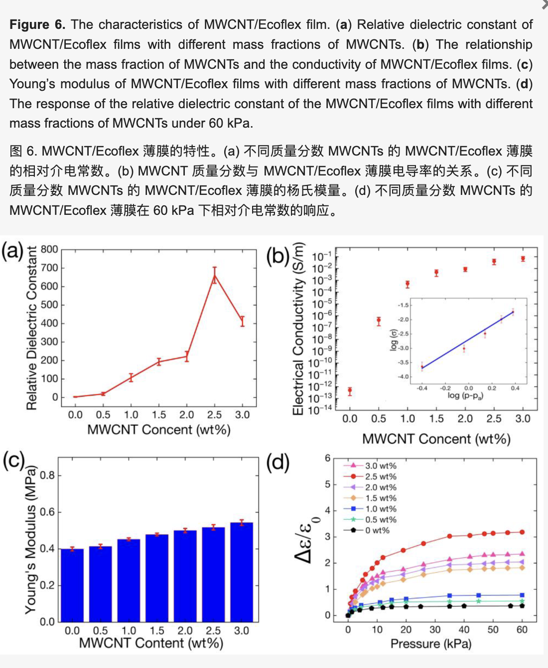
CNT/Ecoflex Electrode
https://www.mdpi.com/2072-666X/16/7/804?utm_source=chatgpt.com
Percolation threshold：0.3wt%
Beyond ≈ 5 wt % the ink becomes viscous, prints poorly, and can inhibit Ecoflex curing.

Slide 6
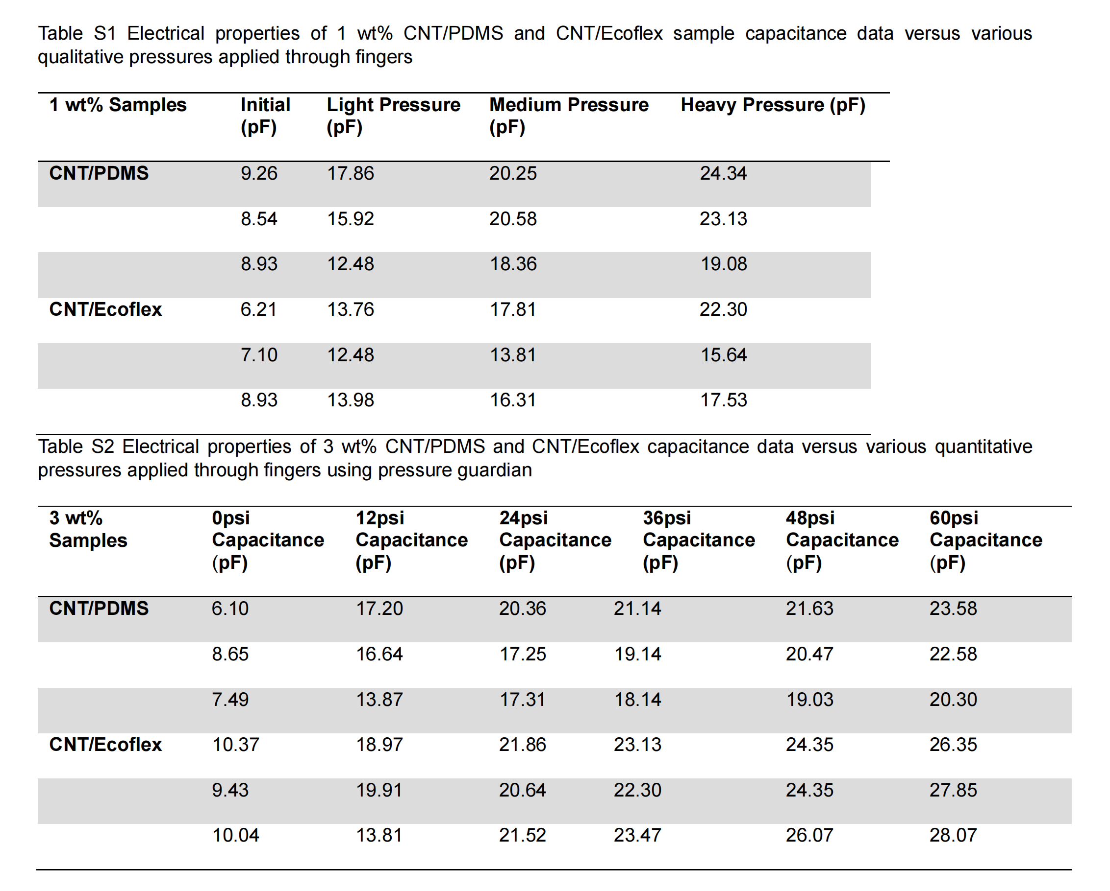
CNT/Ecoflex Electrode
https://www.mdpi.com/2072-666X/16/7/804
2.5wt% CNT
https://pubs.acs.org/doi/10.1021/acsapm.3c01689
Mix ecoflex A and ecoflex B separately with CNT, then combine them together and stir manually. Heat the mixture to 80 degrees, place it in a vacuum to stand for 20 minutes to remove bubbles, and then let it sit at room temperature for one day

Slide 7
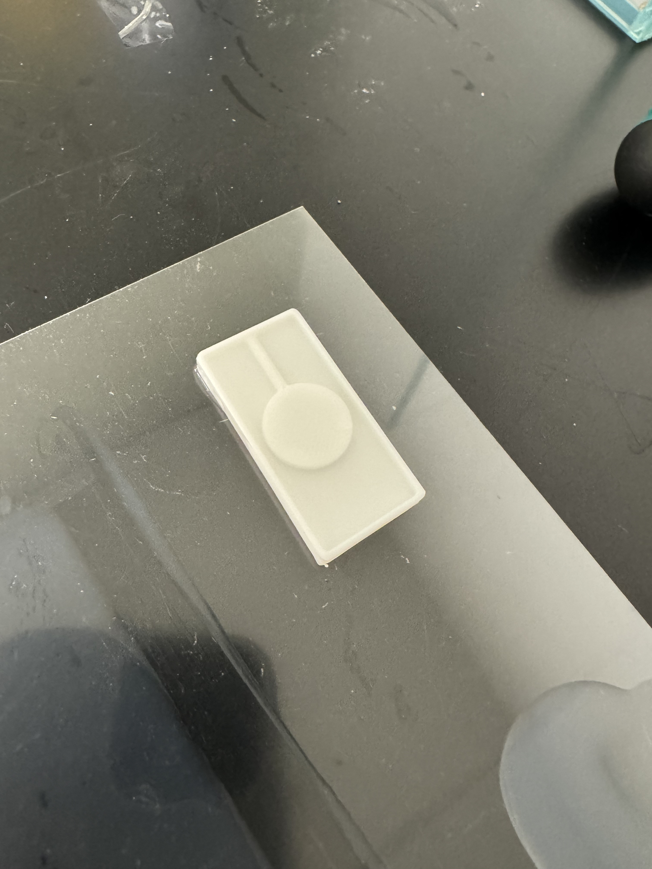
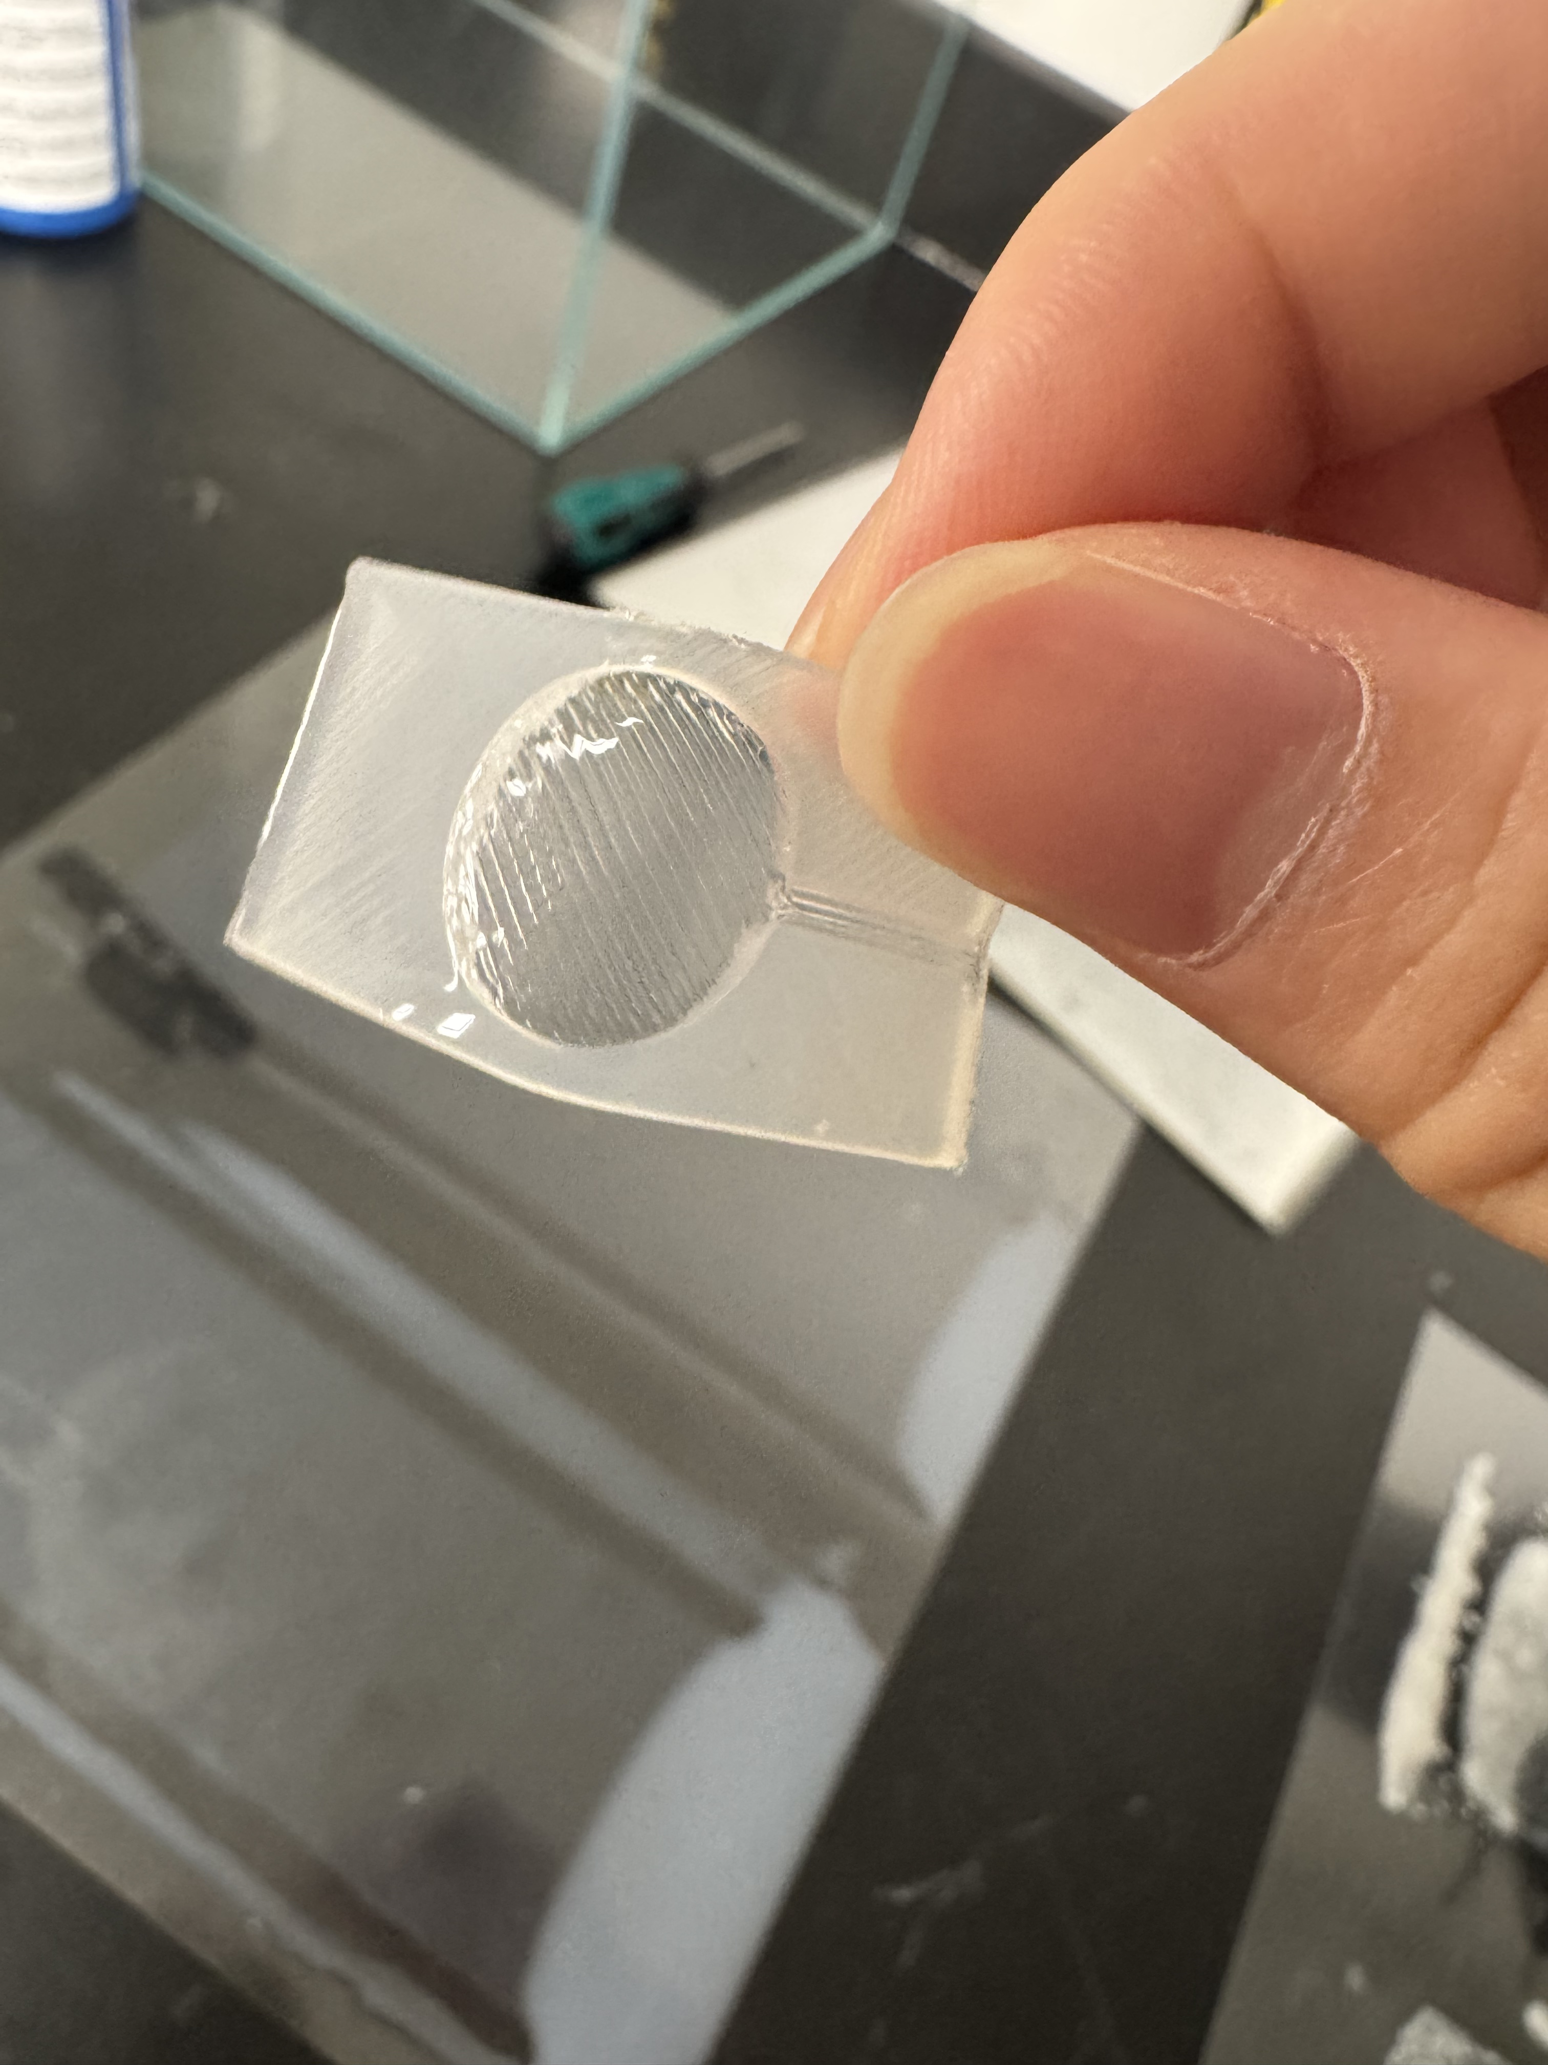
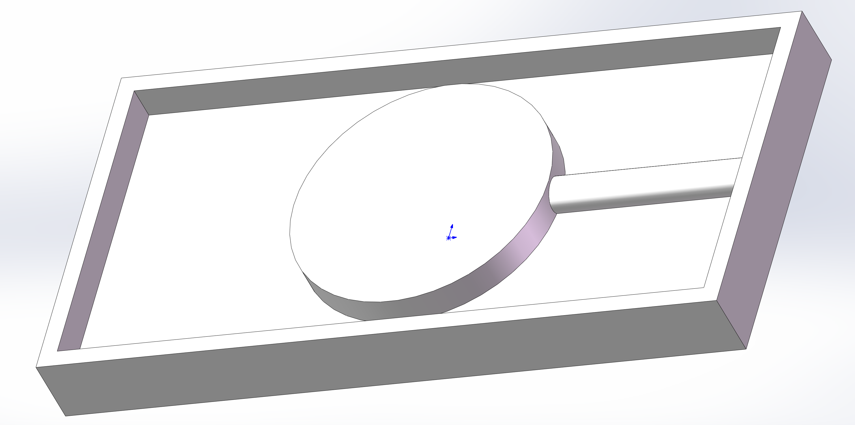
Bubble

Slide 8
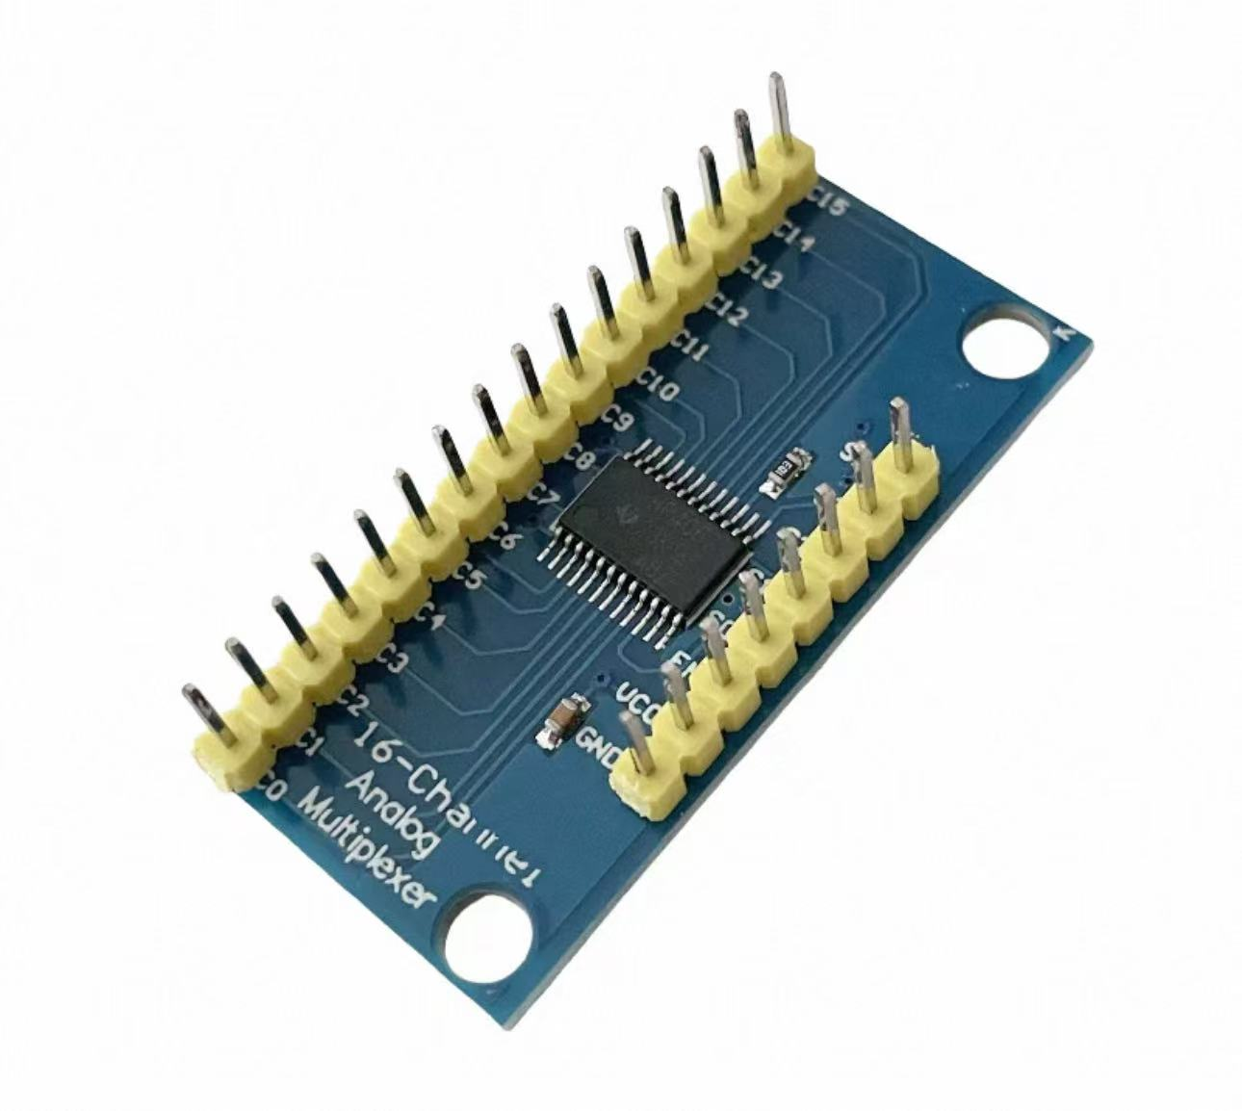
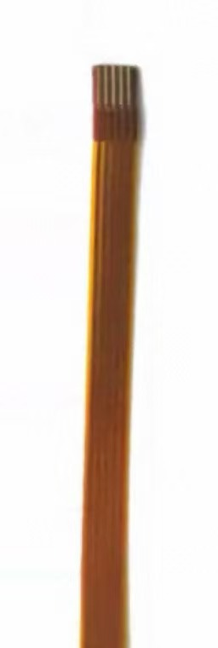
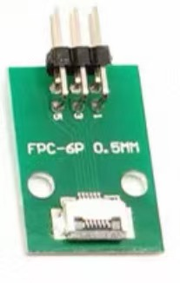
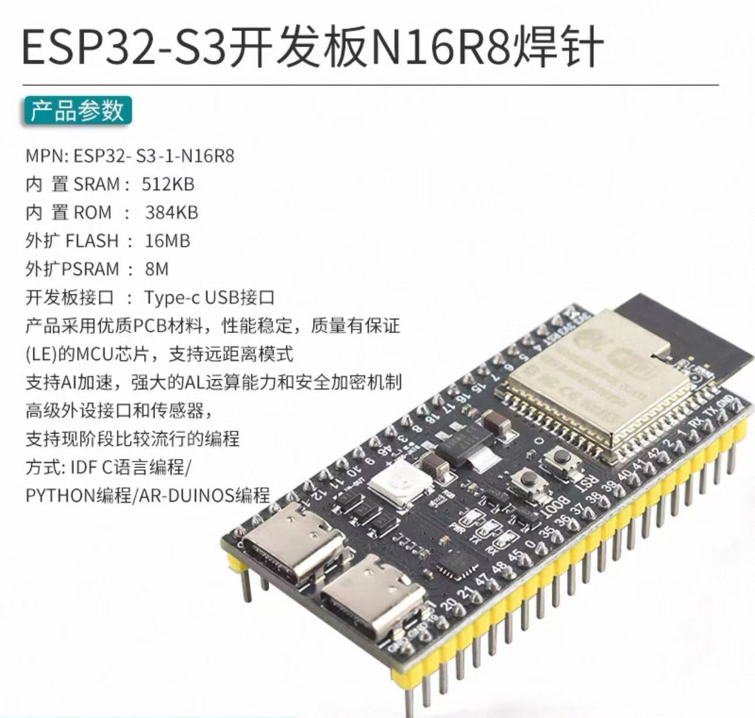
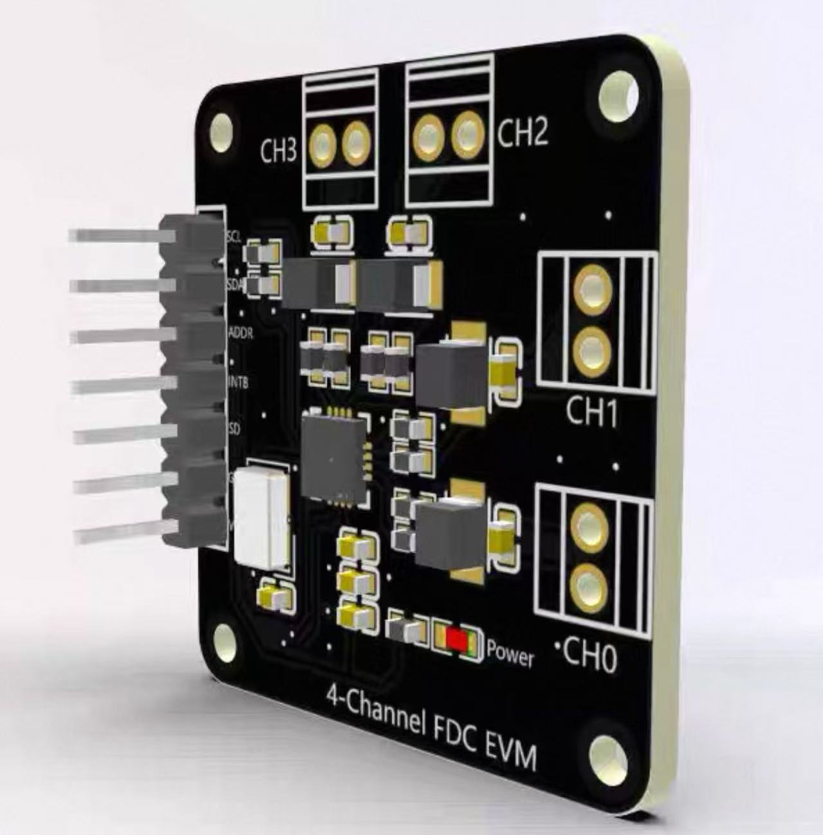
Embedded hardware
Multiplexer
CD74HC4067
FPC 4pin
FPC adaptor
FDC2214
ESP32-S3

